Slide 1
A Holistic Approach On Airfare Price Prediction Using Machine Learning Techniques
Team Details
A. Rajavamshi Goud(20EG105454)
K. Vinay(20EG105458)
T. Ajay Chowdary(20EG105459)
Project Supervisor
B. V. V. Siva Prasad
Associate Professor

Slide 2
Introduction
Globalization of markets involves new strategies and price policies from professionals that contribute to global competitiveness. Airline companies are changing tickets’ prices very often considering a variety of factors based on their proprietary rules and algorithms that are searching for the most suitable price policy. Recently, Artificial Intelligence (AI) models are exploited for the latter task, due to their compactness, fast adaptability, and many potentials in data generalization. This paper represents an analysis of airfare price prediction towards finding similarities in the pricing policies of different Airline companies by using AI Techniques. More specifically, a set of effective features is extracted from data flights of Aegean, Turkish, Austrian and Lufthansa Airlines for six popular international destinations. The extracted set of features is then used to conduct a holistic analysis from the perspective of the end user who seeks the most affordable ticket cost, considering a destination-based evaluation including all airlines, and an airline-based evaluation including all destinations.

Slide 3
Problem Statement
To analyze and predict airfare prices using ML Techniques. A comprehensive set of features is extracted from a dataset of flights for popular international destinations. Machine Learning, Deep Learning and Quantum Machine Learning models are employed to achieve accuracies for predicting ticket costs and help cost conscious travelers find the most affordable options.

Slide 4
Proposed Method
Data Processing:
From the airline dataset Duplicates are removed and Drop cleaning is done.
Splitting the data:
The airline datasets are split into testing data and training data using train_test_split() function for training the model.
Training and Evaluating the algorithms:
Machine Learning, Deep Learning and Quantum Machine Learning algorithms are trained with the data and predicted the output for the input test data. The accuracy of each and every algorithm is stored.

Slide 5
Comparative Analysis and Performance Visualization:
The accuracies from each and every algorithm is stored and compared to take the best predicting algorithm. The Visualization makes it easier to find the best predicting model.
Prediction :
After comparative analysis the best algorithm is taken for predicting the price according to the user requirements.

Slide 6
Experiment Environment:
Programming Language : Python
Machine Learning Libraries : NumPy, pandas, seaborn, matplotlib, scikit-learn
Deep Learning and Quantum Machine Learning Libraries : TensorFlow, qiskit.
Code Development Environment : Jupyter notebook.

Slide 7
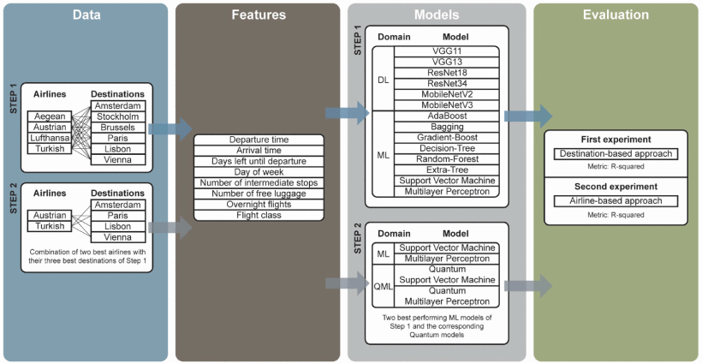
System Architecture:

Slide 8
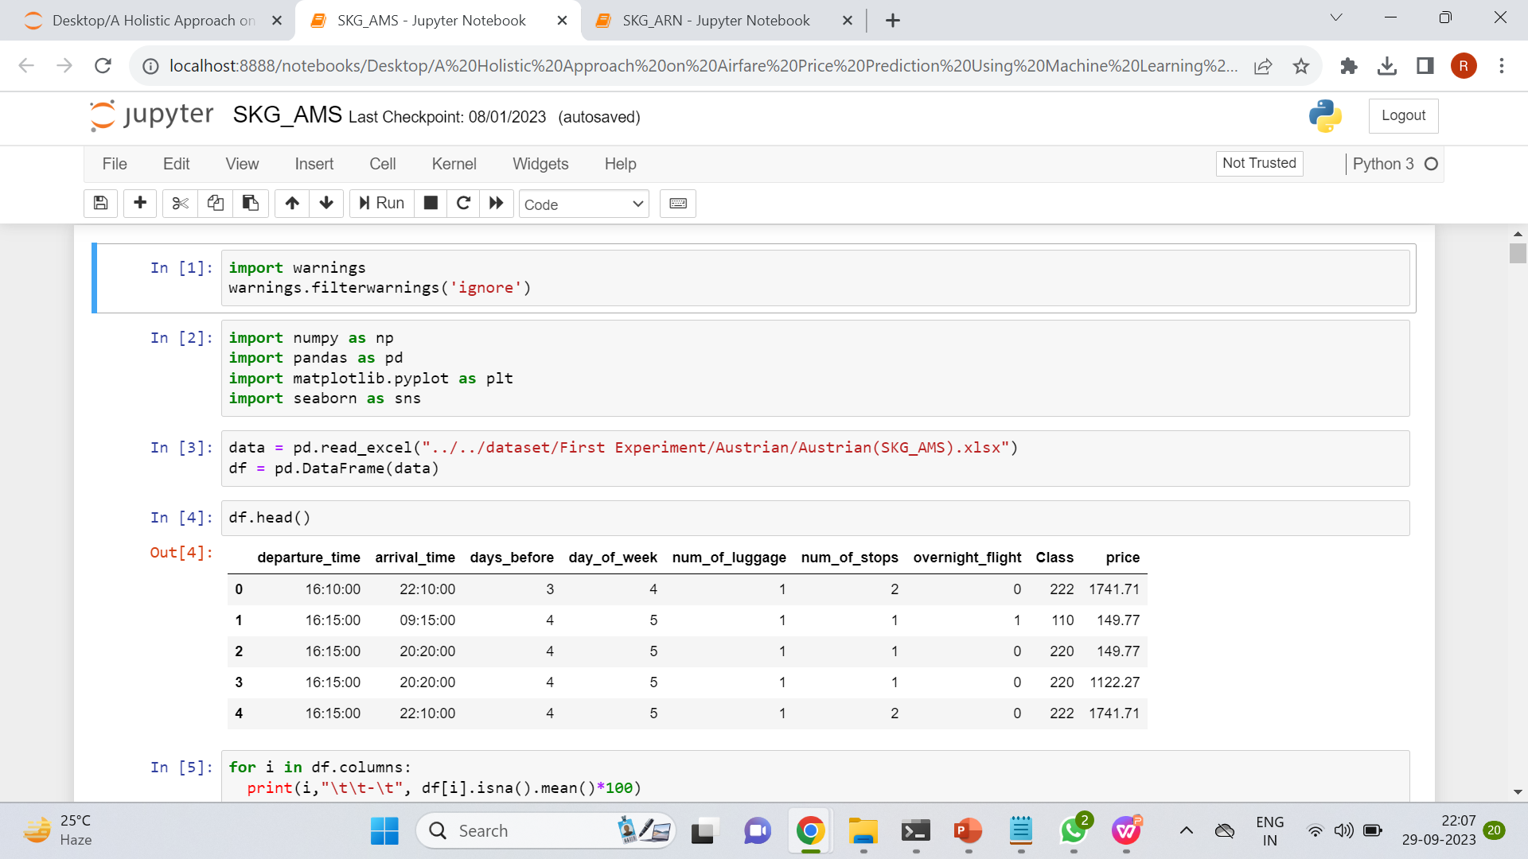
Experiment Screen shorts

Slide 9
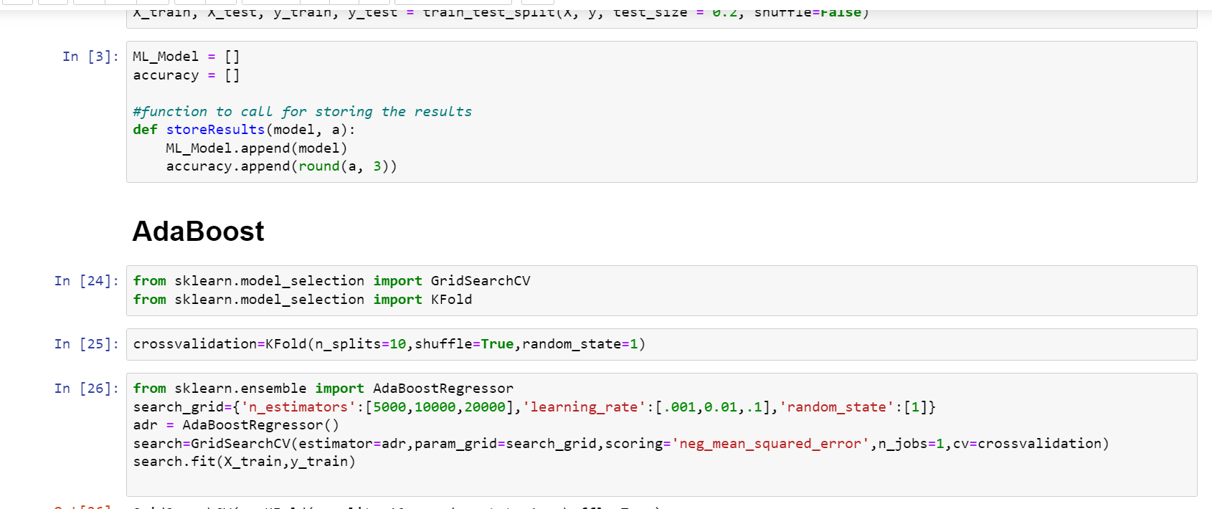

Slide 10
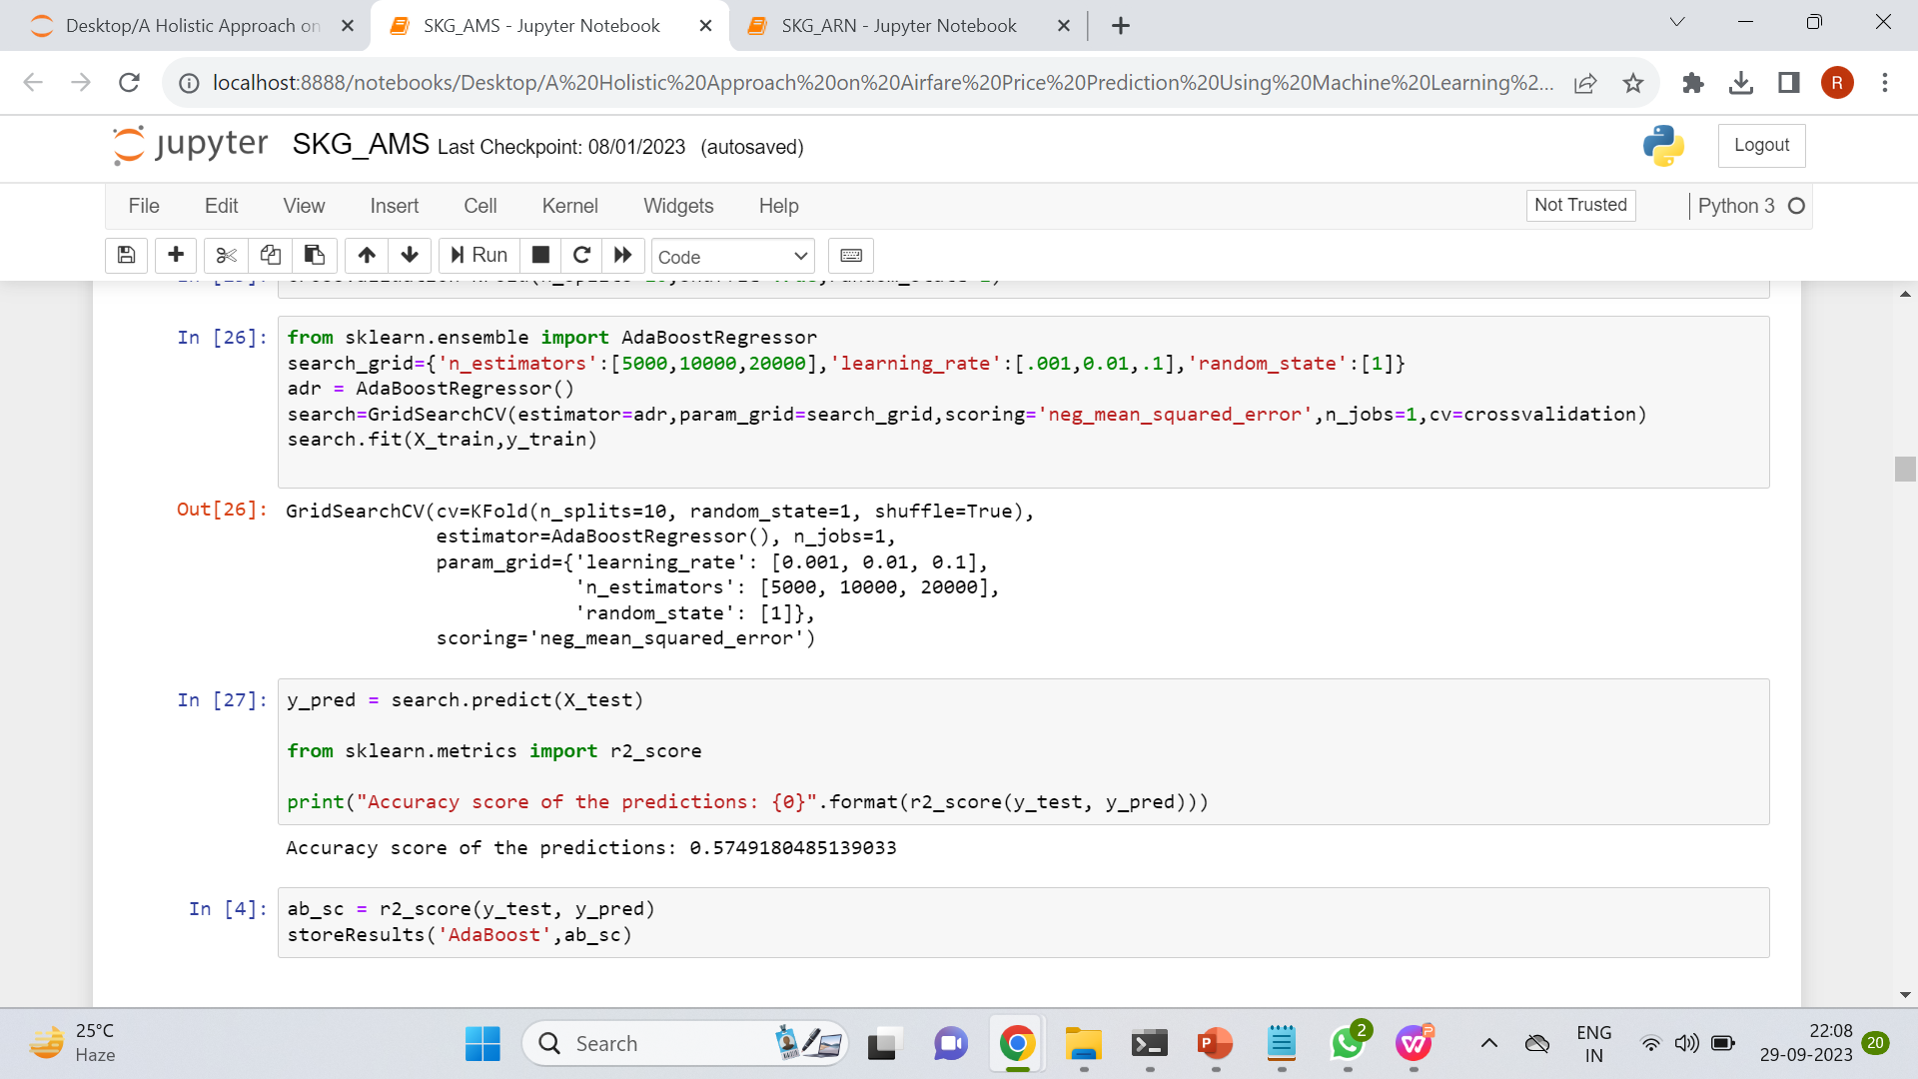

Slide 11
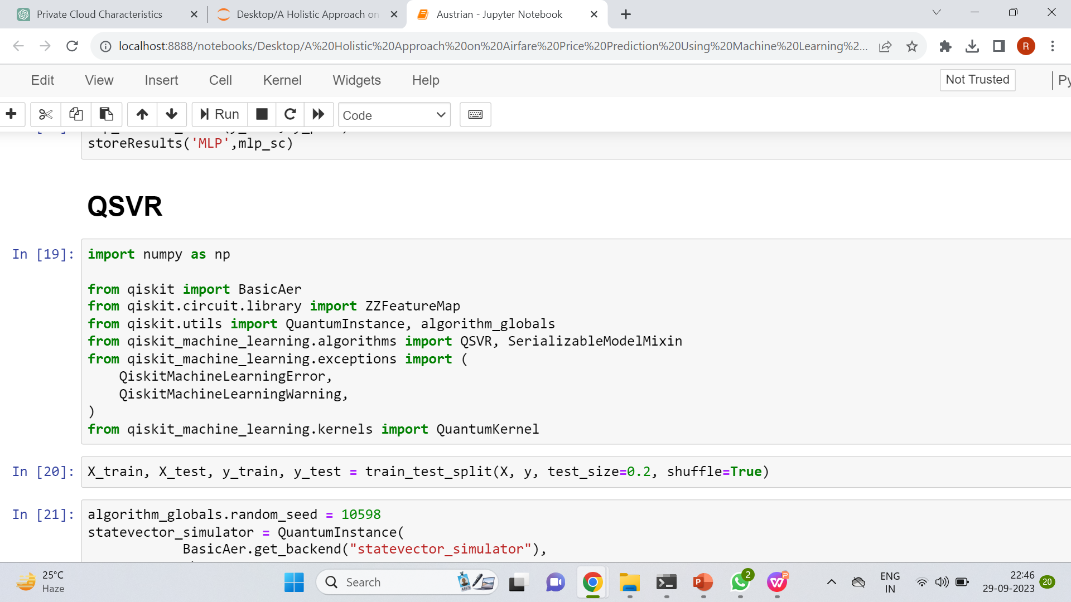

Slide 12
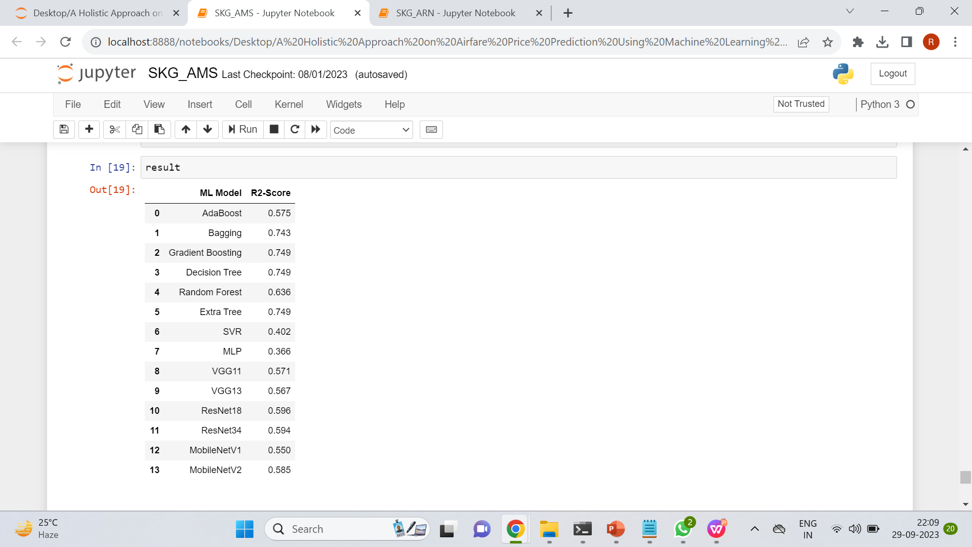

Slide 13
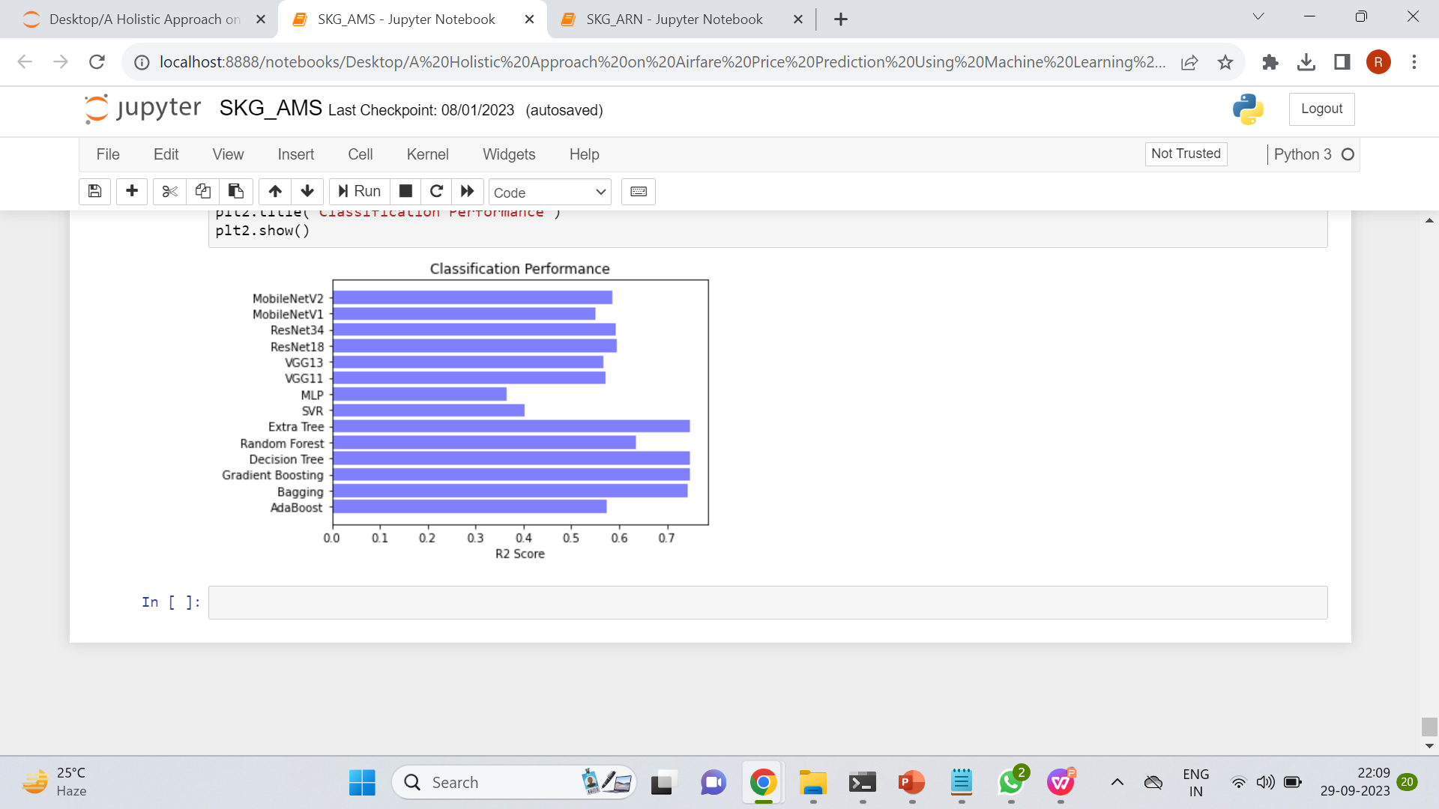

Slide 14
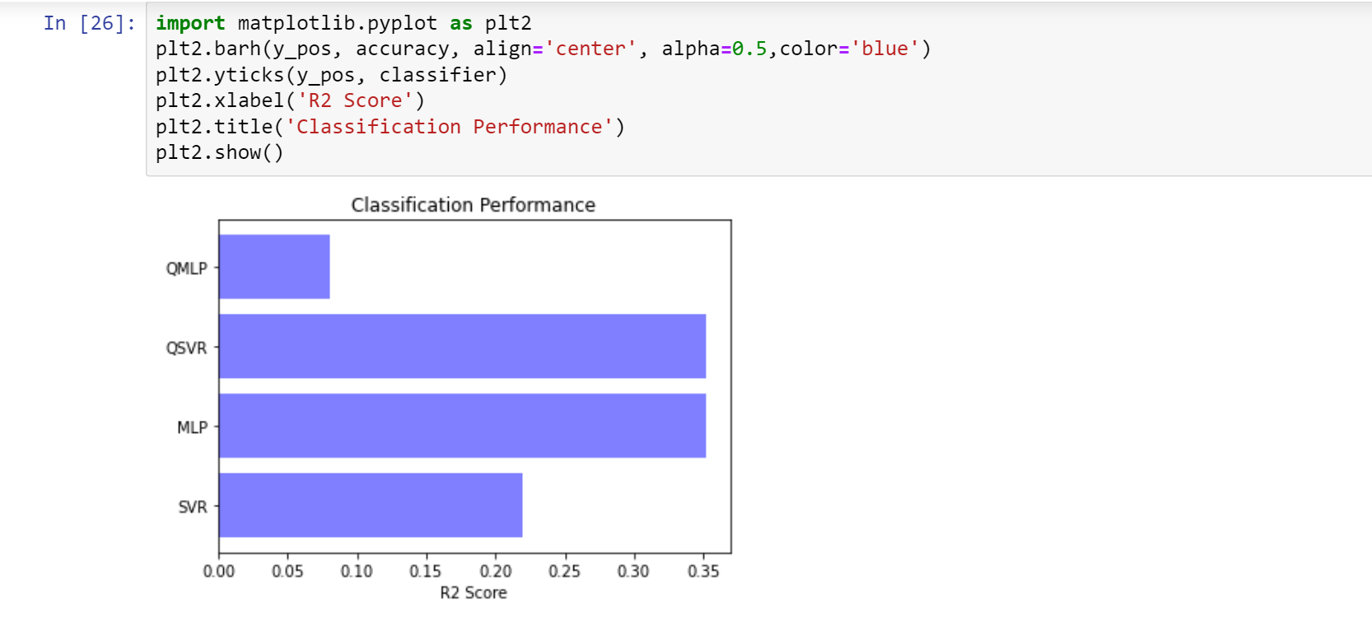

Slide 15
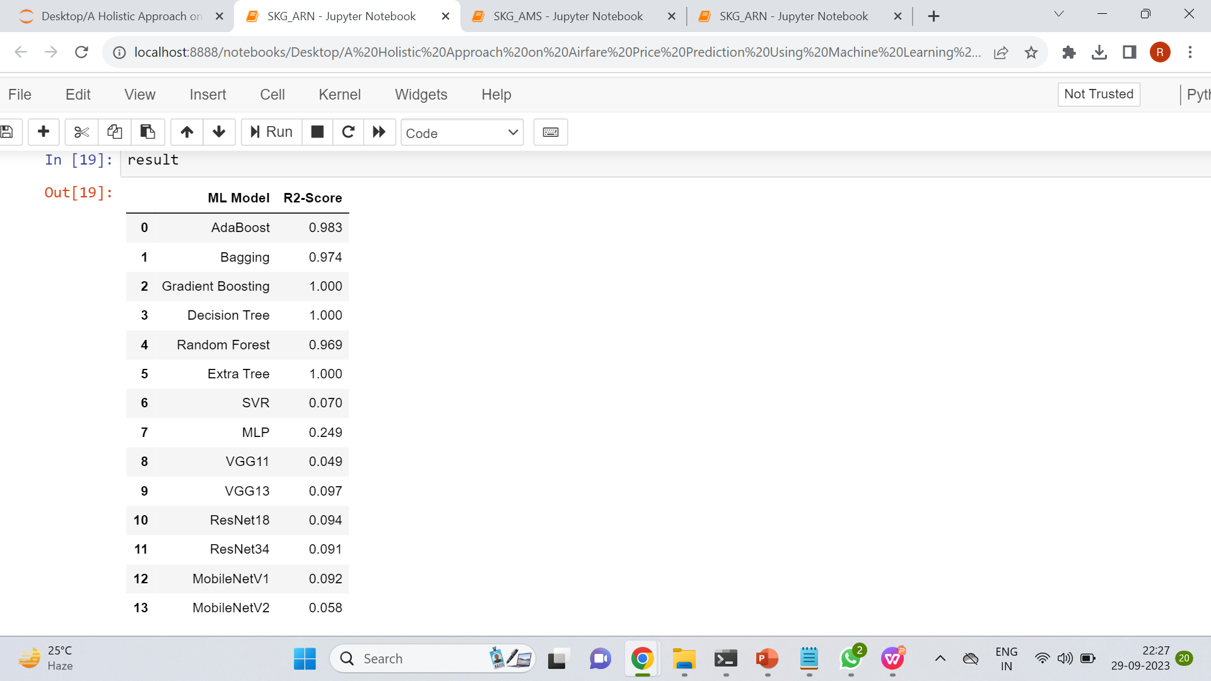

Slide 16
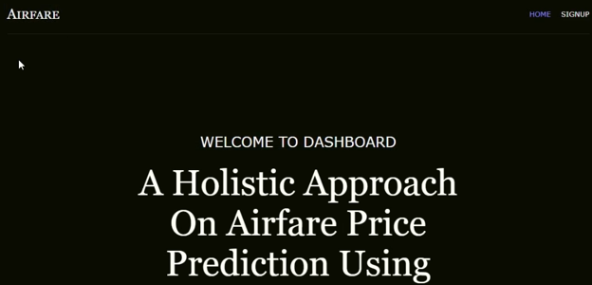
Experiment Results

Slide 17


Slide 18
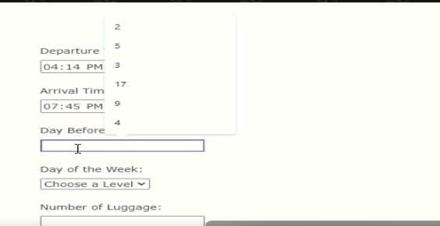

Slide 19
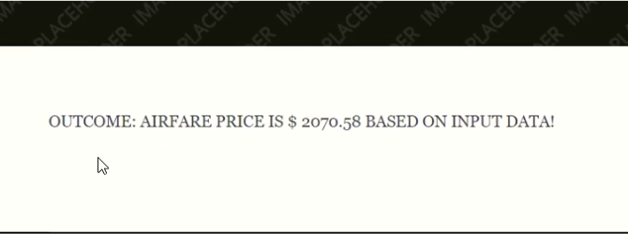

Slide 20
Finding:
In the base paper, the author mentioned to use different dataset like airline based and designation based for analysis the predict the fare of air ticket using different Machine Learning, Deep Learning and Quantum Machine Learning Models. The Austrian Dataset few machine learning models got 95-100% of r2_score which is high comparing to dataset . SO we used Austrian - SKG-ARN dataset with Decision Tree Regressor model which got 100% r2_score to predict the price of an Airfare in the frontend.

Slide 21
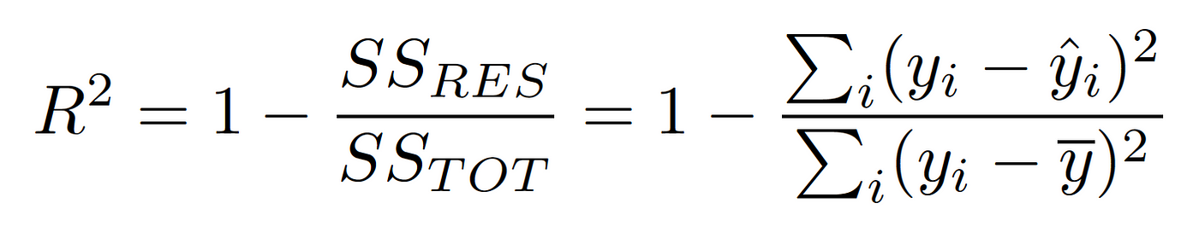
Justification
1.What are parameters improved by your method
Model Diversity and Evaluation
Comparative analysis and Technology Advancement.
Accuracy
2. Mathematic formulas for calculating parameter values
R2_score(coefficient of determination)
3 why your parameter values improved?
Holistic approach for optimized model.

